Slide 1
Silver Pohlig Hellman Algorithm
Number Theory (20MAT112)

Slide 2
MEMBERS!
Group 8
G H HEM SAGAR [CB.EN.U4CYS21016]
GOKULACHSELVAN C D [CB.EN.U4CYS21019]
SANTHOSSH K S [CB.EN.U4CYS21025]
LAKSHMI NARAYAN P [CB.EN.U4CYS21034]
M C VIVEK VEERA [CB.EN.U4CYS21035]
M K ASHWATHA PRASAD [CB.EN.U4CYS21036]
NITYA PRANAV S[CB.EN.U4CYS21052]
RAKSHAN K [CB.EN.U4CYS21059]
SERAN PANDIYAN I P [CB.EN.U4CYS21069]
VINOTH KUMAR C [CB.EN.U4CYS21085]

Slide 3
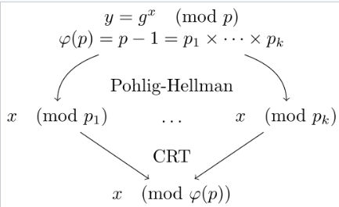
OVERVIEW!
Silver Pohlig Hellman Algorithm is used for computation of discrete logarithms in a finite abelian group.
Discrete logarithms are of the form x=log b mod q or a=b (modq).
Chinese Remainder Theorem is used to find x in the final step.
x
a
Representation of Pohlig-Hellman Algorithm

Slide 4
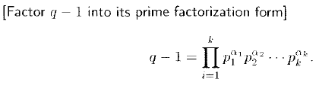

ALGORITHM!
1.
p1,p2,p3,…………..pi are prime factors .
2.

Slide 5
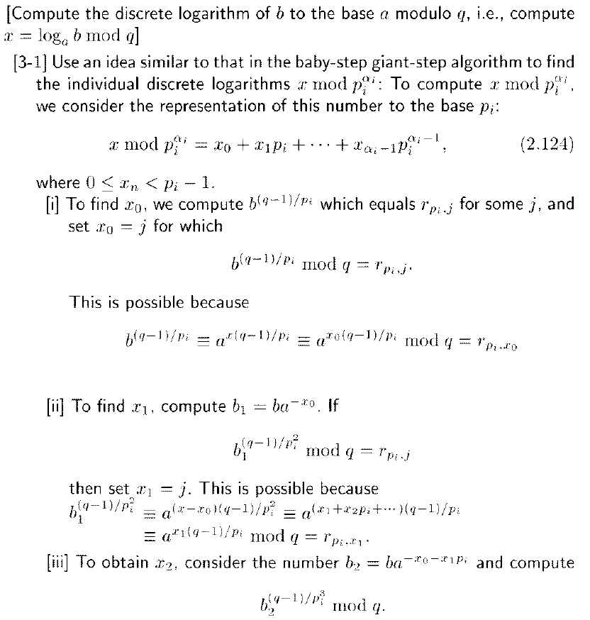
3.
4.

Slide 6
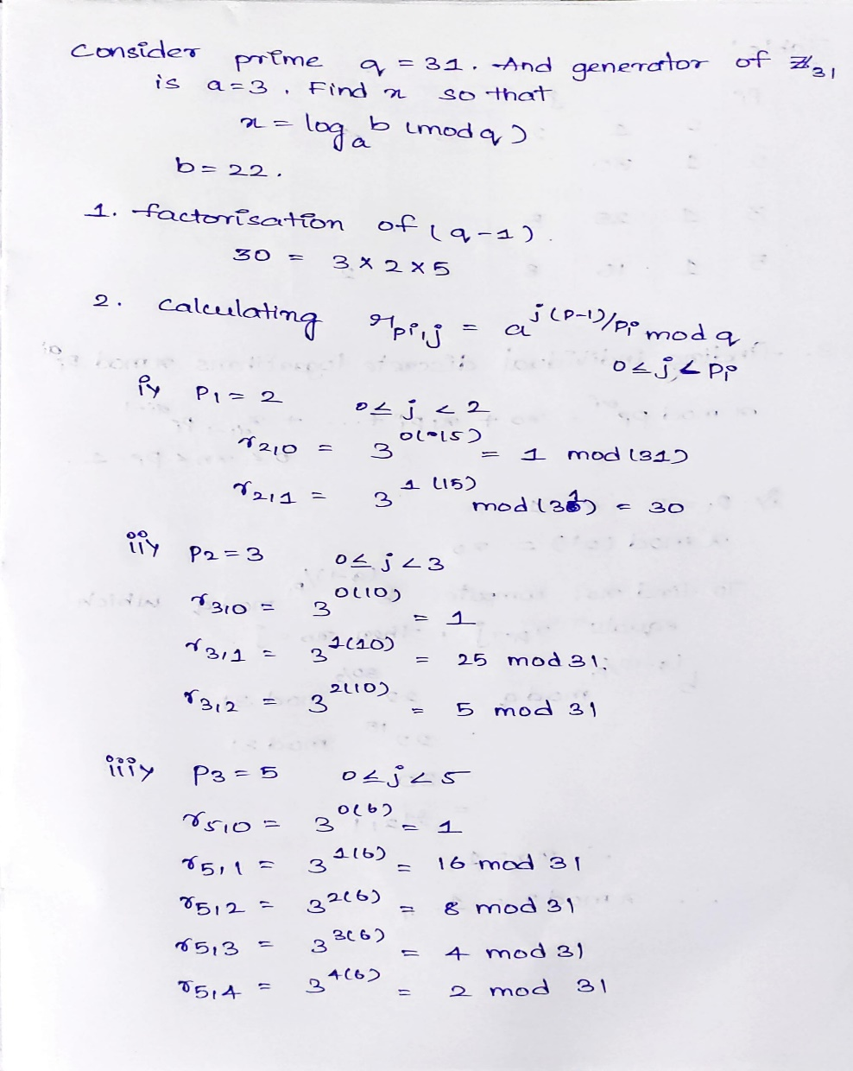
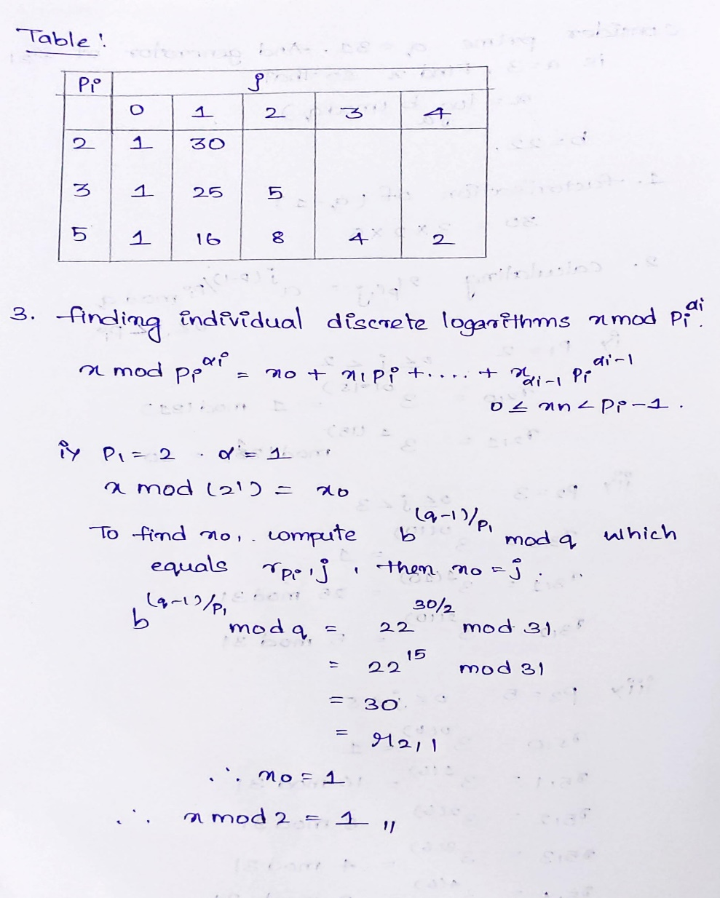
Example

Slide 7
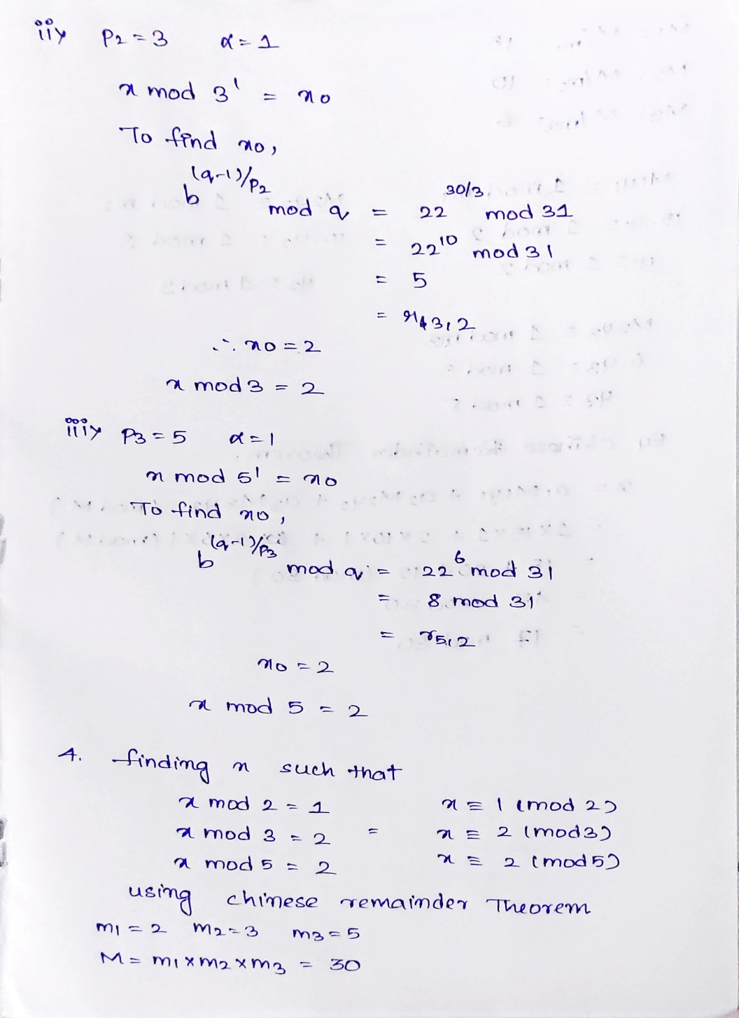
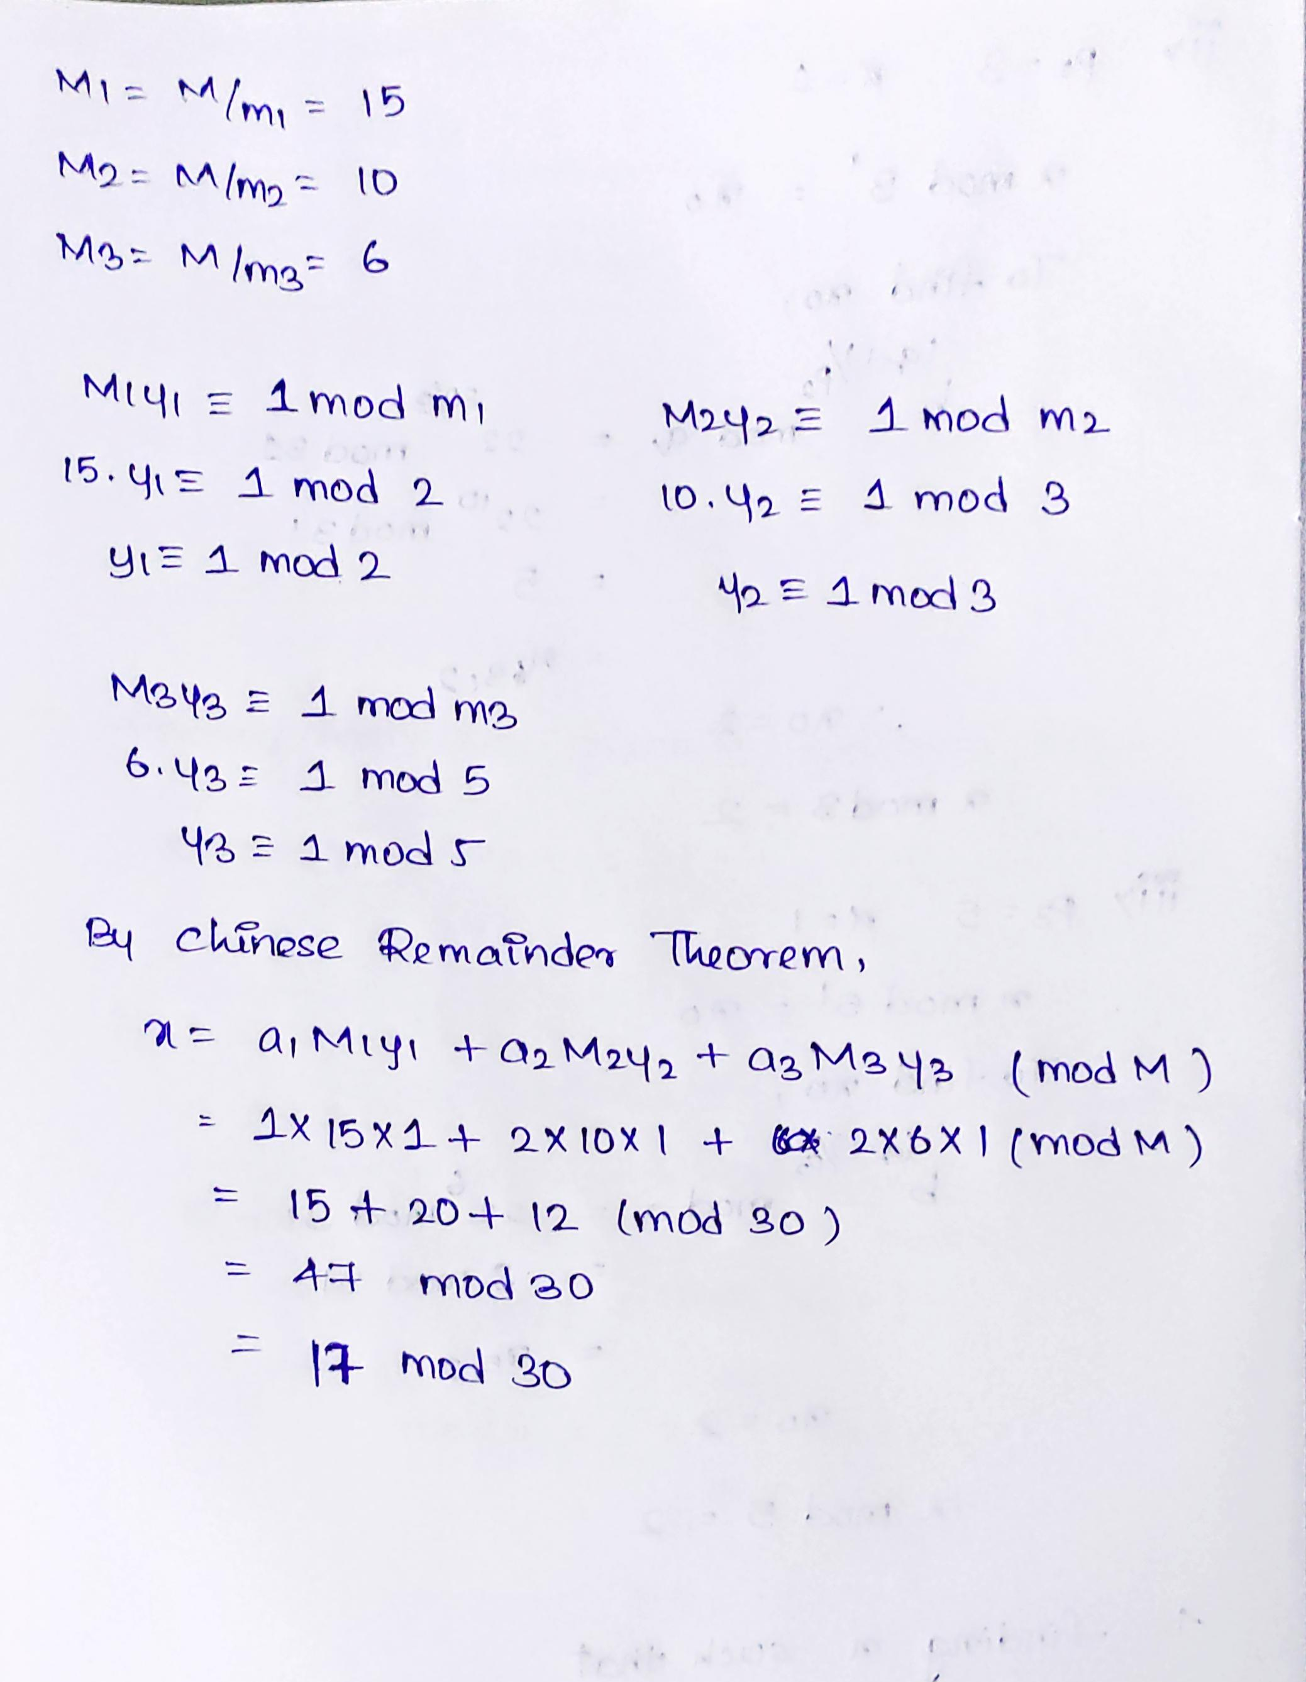

Slide 8
Thank You!!

